Slide 1
How to Use This Training Deck
Updated
12/4/14
This slide deck is designed to give teams and mentors an overview of important concepts so they can achieve a quick start in using FRC LabVIEW on their own.
At the end of each section, there is a list of links with more detailed tutorials, training, and troubleshooting info if you want to explore a certain topic in more detail. (All Quick Start Links are listed on ni.com/frc.)
This training will be updated throughout the FRC season as I get more feedback on ni.com/frc.
Be sure to install LabVIEW before the presentation and read the notes because they contain a lot of additional information.
This slide is hidden by default.

Slide 2
FRC LabVIEW Quick Start Guide
FRC 2015 Training Material
Setup
NI LabVIEW
Basics
Vision, PID, and Simulation
Advanced Programming
Notes:
The FRC LabVIEW Quick Start Guide is designed to give teams a quick overview of the software, tools, and utilities they need to program an FRC robot using LabVIEW.

Slide 3
FRC LabVIEW Quick Start Guide
Setup
Software Setup Overview
FRC Software Orientation
roboRIO Introduction and Set Up
Basics of the Robot Project
Deploying and Driving
NI LabVIEW
Basics
Vision,
PID, and Simulation
Advanced Programming
Notes:
The setup module helps you download and install your software, orient yourself with the software components, connect to your roboRIO controller, and deploy the existing template project. If your hardware is already set up, you should have a drivable robot at the end of this section—no programming required (yet).
This training does not cover hardware build instructions.

Slide 4
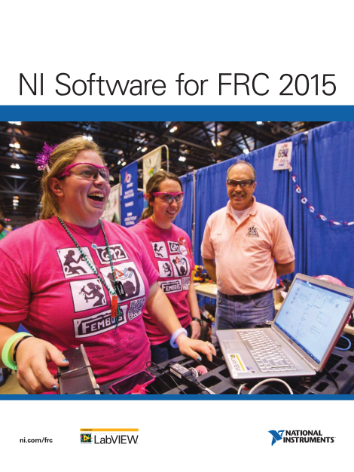
FRC Software Overview
Setup
NI Software for FRC 2015
Included in Kit of Parts
or
Download at ni.com/frc
LabVIEW 2014
LabVIEW 2014 Real-Time
Vision Development Module
IMAQdx 14.0 (vision driver)
NI-RIO (roboRIO driver)
FRC 2015 Simulation
FRC 2015 Update Suite
Required for ALL FRC Teams
Download Only
Download Only
Driver Station
roboRIO Utilities
WPI Library
FRC LabVIEW Templates
FRC LabVIEW Examples
All download links available at ni.com/frc.
Notes:
All teams should get an “NI Software for FRC 2015” cardboard envelope in their kit of parts containing the NI Software DVD. You can use the DVD to install the standard NI software. Be sure to save this envelope in case you need to reinstall or reactivate later.
If you don’t have a DVD drive or you want the NI software before you get your kit of parts, you can also download it at ni.com/frc. It is a 4.6 GB download, so it may take a while depending on your Internet connection. Even if you download the software, you still need the serial number from the DVD envelope to activate it.
Regardless of what software your team plans to use (C++, Java, LV) you need to download the FRC 2015 Update Suite. It includes the driver station, dashboard, roboRIO imaging tool as well as all of the FRC specific content like the FRC Examples and Templates. (~900MB)

Slide 5
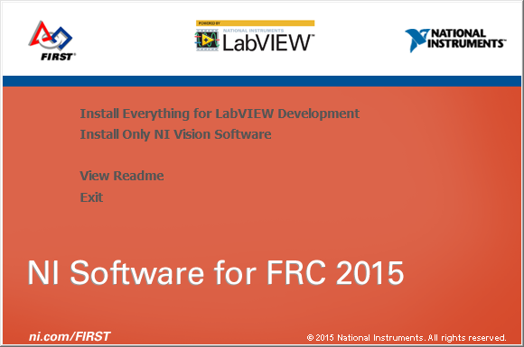
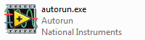
1. Install NI Software
Setup
NI Software for FRC 2015 (DVD or Download)
If you download the software, you must unzip and run AutoRun.exe.
If you program in LabVIEW
If you program in C++/Java but want to use NI vision
Notes:
Use the DVD from your kit of parts or download the “NI Software for FRC 2015” file from ni.com/frc. Once you download the software click on Autorun.exe
[Note to instructor: Be sure to explain that they need to download, unzip, and then install the software. We’ve gotten a lot of questions about this.]
Click next on the first screen and then select the products you would like to install.
[Animation]
If you plan to develop your robot in LabVIEW, install all of the components.
If you are using C++ or Java but still want to use the NI Vision Development Module, just install it and deselect all of the other components.

Slide 6
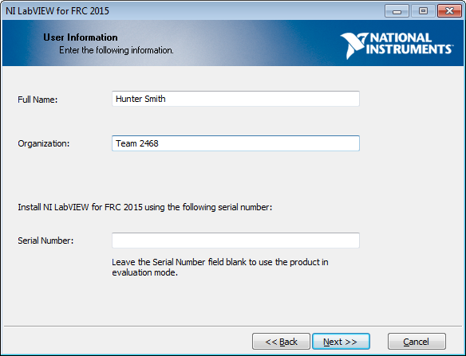
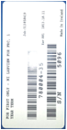
2. Activate
Setup
Activate LabVIEW using the serial number on the back of the DVD envelope.
Serial Starts with M
Notes:
During the installation process, you will be prompted for the serial number on the back of the DVD envelope. Be sure to enter your team number for the organization.
If you don’t have your kit of parts yet, you can leave the serial number blank to install as a trial until you get your serial number.
Later in the installation process, you will be prompted to activate Vision. Use the same serial number.

Slide 7
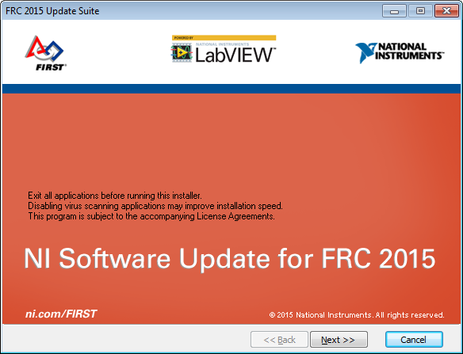
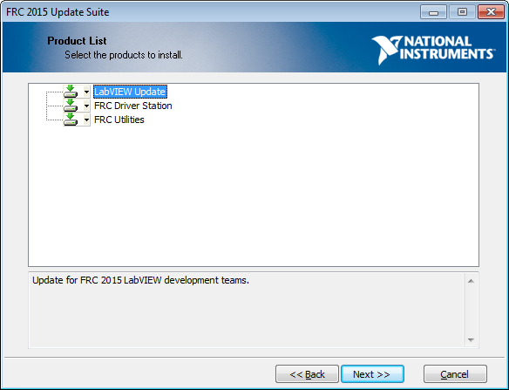
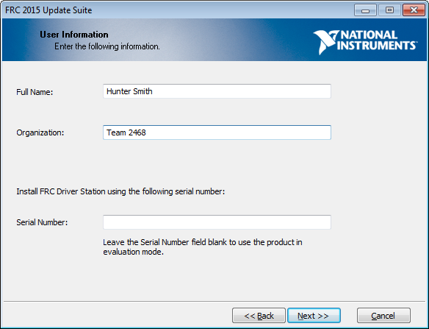
3. Install FRC 2015 Update Suite
Setup
All teams must install the Update Suite.
Install Update after LabVIEW
Install Components
LabVIEW Teams : Everything
Java/C Teams: Driver Station & Utilities
Activate with the same serial number from the DVD Envelope
Notes:
The FRC 2015 Update Suite contains all of the FRC-specific software made by NI.
[Animation]
All teams need to install the FRC utilities to image the roboRIO controller and install the FRC Driver Station to control their robots.
If you are using LabVIEW, you need the LabVIEW Updates to install the FRC specific content and FRC project templates.
[Animation]
The FRC Update Suite include vision components that need to be activated, so use the same serial number from your FRC DVD envelope

Slide 8
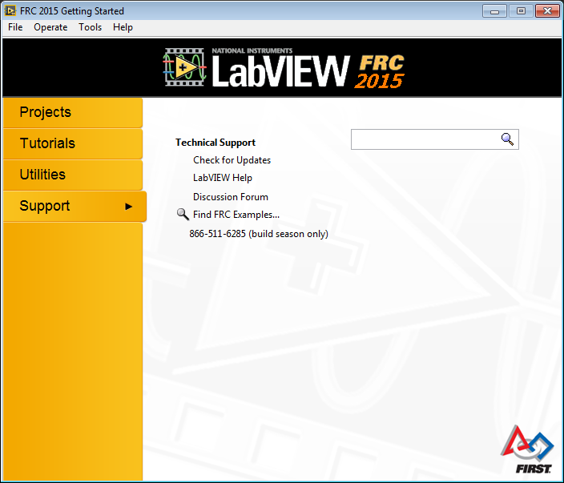
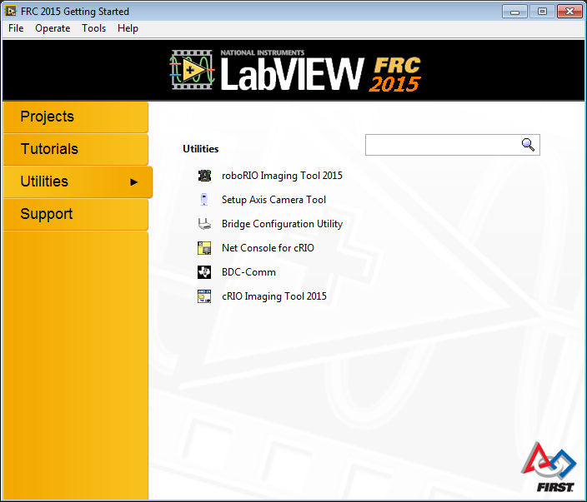
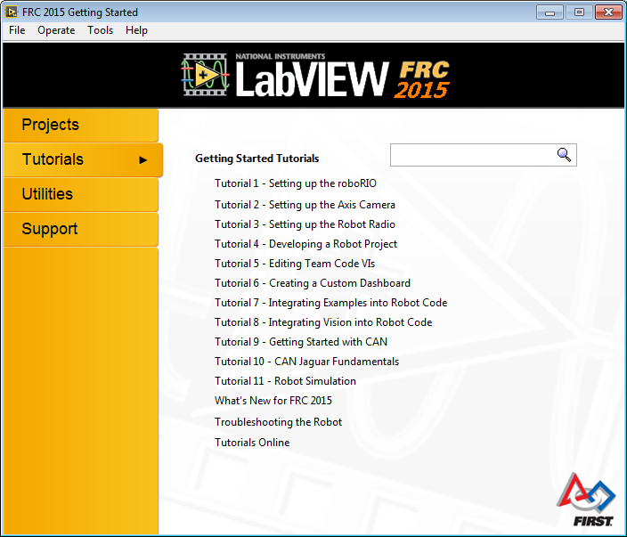
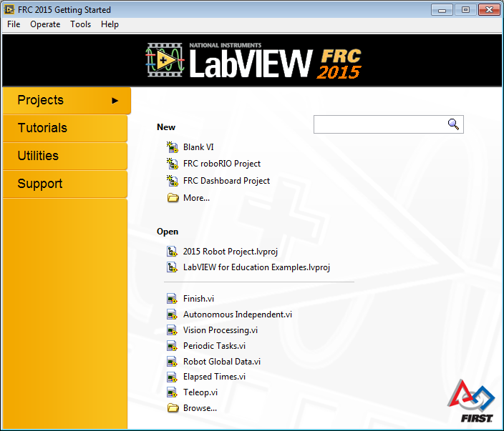
Software Orientation: Getting Started Window
Setup
This window opens when you start FRC LabVIEW.
! Requires FRC 2015 Update Suite !
Built-In Training
Tools
Create New Project
Help
Recent Projects
Call for Help
Notes:
After you install LabVIEW and the Update Suite and when you start LabVIEW, you will see the FRC Getting Started window.
This window is packed with useful information and tools.
Note: You can open the Getting Started window by closing all VIs and projects OR you can go to View»Getting Started Window from any LabVIEW window.
Project: When you are ready to start programming, just create a new FRC cRIO Robot Project to get a project with everything set up and ready to go.
[Animation]
Tutorials: Start with the tutorials to explore in detail different aspects of LabVIEW and the roboRIO controller.
[Animation]
Utilities: This section offers quick links to all of the tools and utilities you need for FRC.
[Animation]
Support: If you ever get stuck, use the link to the forums as well as the phone support number to get help from an engineer during the build season.

Slide 9
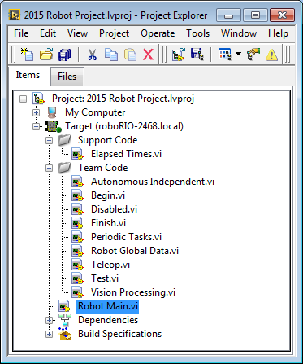
Software Orientation: roboRIO Robot Project
Setup
With the LabVIEW project window, you can see all of the code that will run on your robot. The FRC software includes a template project with everything you need to start.
All the code you need to change is in the Team Code folder
Robot Main communicates with the field control system and runs your team code
(don’t edit)
Notes:
Use the LabVIEW project to organize many LabVIEW programs or virtual instruments (VIs) in one place. When you create a new roboRIO Robot Project, it includes all of the VIs you need.
Robot Main is the program that communicates with the field control system and runs all of your team code. You should not need to edit this.
The VIs your team needs to edit are included in the Team Code folder. Each VI features instructions and example code to help you get started.

Slide 10
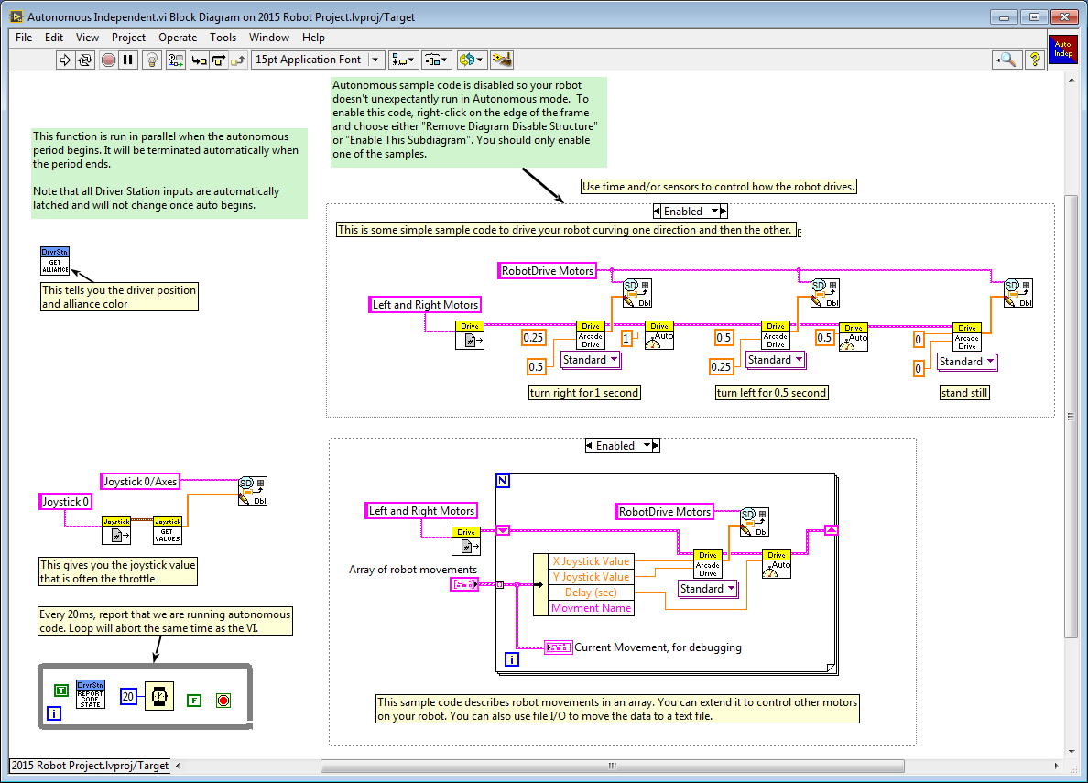
Software Orientation: Team Code
Setup
This is the Autonomous Independent VI for creating your autonomous program. This is one of the VIs you need to edit.
Instructions Included
Edit this code
Edit this code
Notes:
The Autonomous Independent.vi is one of the VIs in the Team Code folder. The default code shows you how to access all of the inputs and sensors you need to make a smart autonomous program. Be sure to read through all of the instructions so you know what everything does.

Slide 11
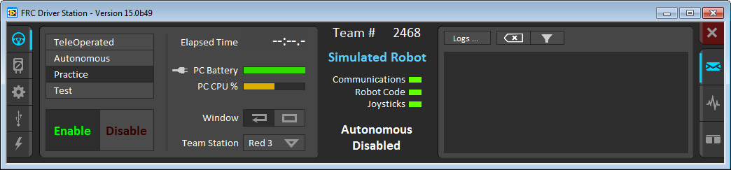
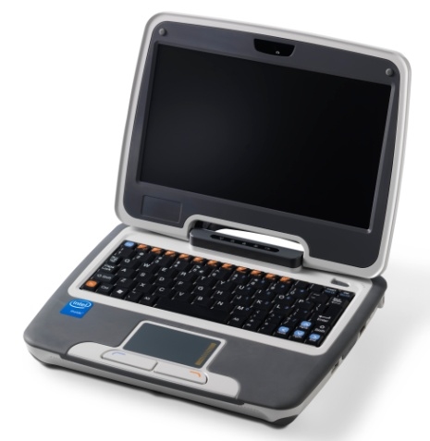
Software Orientation: Driver Station
Setup
The Driver Station is the robot control utility for practice and competition for all FRC teams. Open this to connect to your robot and run your code you wrote.
Operation Tab
Robot Info Section
Messages Mode
Mode
All lights should be green to run
Find out more about it here: https://decibel.ni.com/content/docs/DOC-26297
Notes:
The Driver Station is an executable utility that all FRC teams are required to use on their driver station PCs. Once you have written your code, you can connect to the roboRIO controller and deploy and run your code from here.
The right side and left side of the dashboard allow you to select different tabs independent and the middle Robot Info section is always visible.
Operation tab: This tells you which stage of the game you’re in, and info about your Dashboard PC. From here, you can enable your robot, test your code, and set up for competitions.

Slide 12
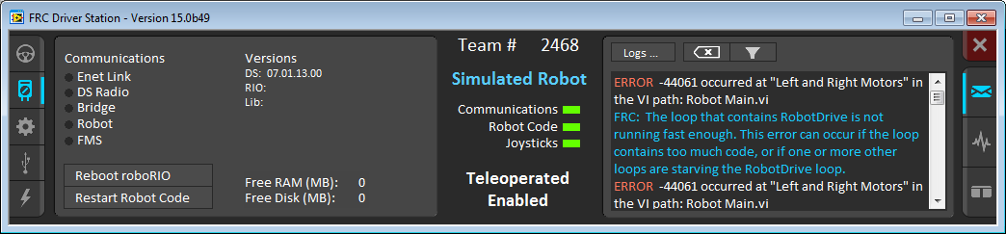
Software Orientation: Driver Station
Setup
Diagnostics Tab
Error Messages
Easily Reboot or Restart from the dashboard
Find out more about it here: https://decibel.ni.com/content/docs/DOC-26297
Notes:
The Driver Station is an executable utility that all FRC teams are required to use on their driver station PCs. Once you have written your code, you can connect to the roboRIO controller and deploy and run your code from here.
Diagnostics tab: This includes communication info versions and includes buttons to easily reboot your roboRIO or relstart the code.
This page also shows and error message on the Messages section

Slide 13
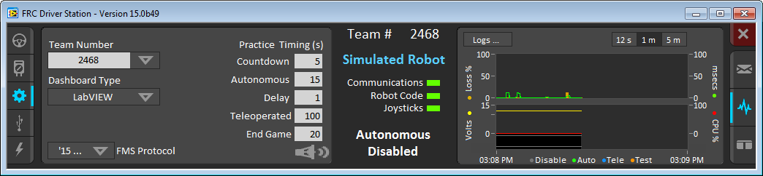
Software Orientation: Driver Station
Setup
Set Up Tab
Configure Match Settings
Chart Mode
Find out more about it here: https://decibel.ni.com/content/docs/DOC-26297
Notes:
On the left we see the setup tab- This is where you configure your team info, set practice round timing, and choose your dashboard type.
On the Right the Chart mode where the dashboard shows info about the battery state, communication, and CPU information.

Slide 14
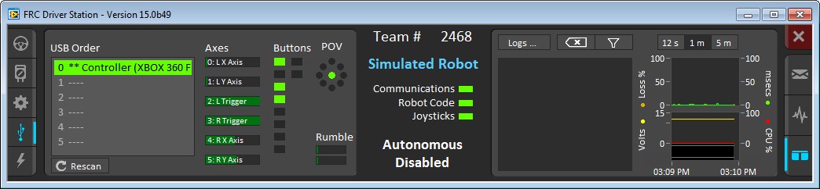
Software Orientation: Driver Station
Setup
USB Devices Tab
Messages & Chart Mode
Live Joystick Inputs
Find out more about it here: https://decibel.ni.com/content/docs/DOC-26297
Notes:
On the Left we have the USB devices Tab which shows controllers other USB devices connected to your dashboard computer, and displays live inputs from your joystick(s)
On the right we are showing the messages and chart mode where both sets of diagnostic info are visible at once.

Slide 15
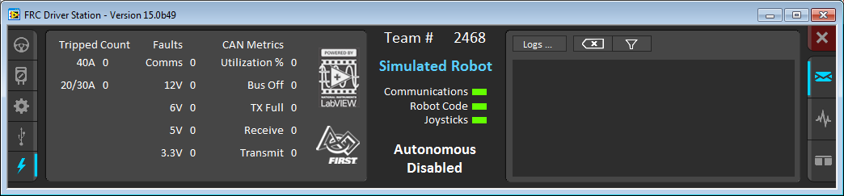
Software Orientation: Driver Station
Setup
Power & CAN Tab
Find out more about it here: https://decibel.ni.com/content/docs/DOC-26297
Notes:
And finally on the Power & CAN tab we can find basic info about the CAN connections and Power Distribution board if the PD board is connected over CAN.

Slide 16
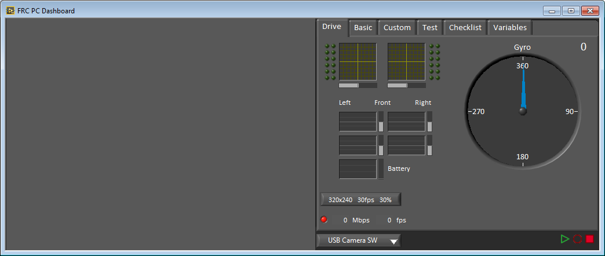
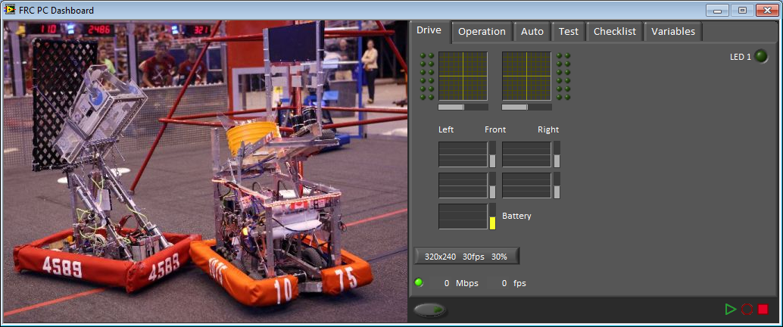
Software Orientation: Dashboard
Setup
The Dashboard is a customizable display and control utility that you can use to read the current status of controllers, sensors, motors, and more.
Controller inputs
and motor status
Different tabs for more functionality
Camera view
Record and playback feature
Notes:
Most students don’t realize that the Dashboard is different from the Driver Station since the Dashboard launches with the Driver Station by default.
The Driver Station is used to enable communication and work with the robot, but the Dashboard allows real-time monitoring while the code is running.
It’s a great tool for testing code, troubleshooting, or obtaining general robot status information.
You can also customize it for your team’s robot and specific needs. To create your own custom Dashboard, open the FRC Dashboard project from the Getting Started window and follow the instructions.

Slide 17
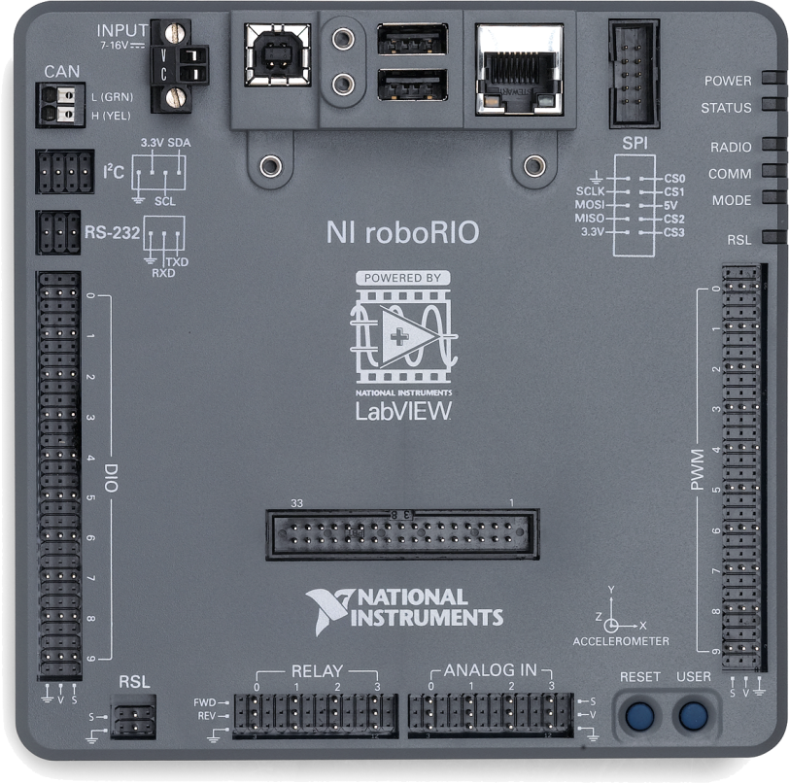
roboRIO
Setup
New controller for FRC 2015-2019
USB Programming / Deployment
USB Webcam / Flash drive …
Zip Tie Mounting Holes
CAN Support
RS-232 / I²C / SPI serial interfaces
Eliminates Digital Sidecar
Dual Core Processor
MXP Custom Electronics Expansion Port
Built-In Accelerometer
Designed for FRC
User Button
Notes:
roboRIO was designed by National Instruments specifically for FRC. It is packed with features that should make it easier for teams to build more advance robots with a larger variety of inputs. Every team should receive a donated roboRIO in the Kick Off Kit and spare controllers are available from AndyMark. If you have detailed questions or want to learn more about the specifications please visit the roboRIO page on ni.com/frc

Slide 18
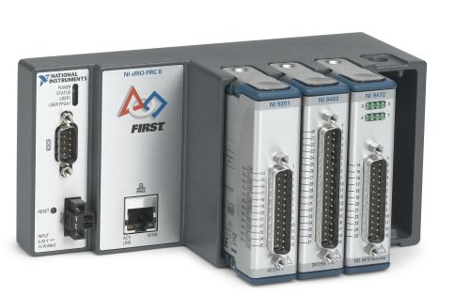
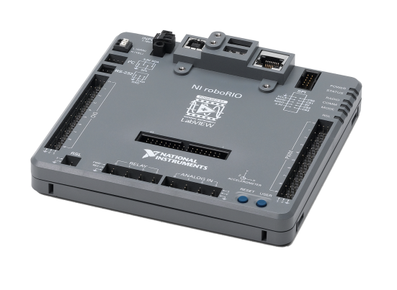
roboRIO vs cRIO
Setup
Controller | cRIO FRC II | roboRIO
Processor | Freescale 5125 400MHz PPC | Xilinx Zynq 7020 667Mhz dual-core ARM Cortex-A9
OS | VxWorks | Linux with Real-Time Extensions
RAM | 128MB | 256MB
Disc | 256MB | 512MB
Volume | 110 in³ * | 30 in³
Mass | 60oz * | 10oz
Price | $689 * | $435
Specs include cRIO, modules, and 2 digital sidecars
Notes:
Compared with cRIO the roboRIO is significantly faster, smaller, lighter, and less expensive.

Slide 19
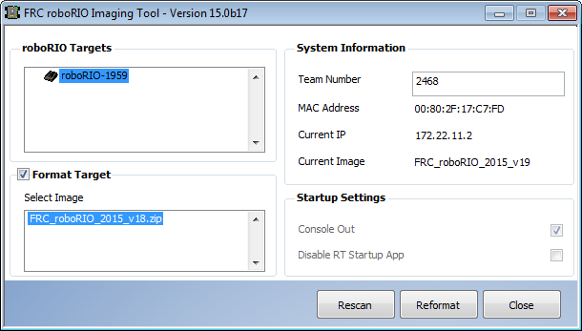
roboRIO Set Up
Setup
Power
PC
Install the FRC 2015 Update Suite
Connect roboRIO to a power supply
Connect roboRIO to your PC over USB
Run the roboRIO Imaging Tool
Share your unboxing experience using #roboRIO
Notes:
When you get your roboRIO follow a few easy steps to get the controller ready for development and competition.
1. First install all software. If you are programming in LabVIEW install LabVIEW, THEN the FRC Update Suite. If your team is not using LabVIEW just install the Update Suite.
2. You will need to connect roboRIO to a power source, you can either connect it to the 12V port on the Power Distribution panel or connect it to any 7-16V DC power source.
3. To image roboRIO you will need to connect the roboRIO to your PC using a A-B USB cable (cable not provided in the box).
4. Now just run the roboRIO Imaging Tool: If you have LabVIEW installed you can find the imaging tool on the Utilities tab of the Getting Started Window, if you don’t have LabVIEW installed you can find the imaging tool by seraching from the start menu or by navigating to your LabVIEW Directory
IE: (C:\Program Files (x86)\National Instruments\LabVIEW 2014\project\roboRIO Tool)
The Imaging Tool will automatically detect the connected roboRIO, then click Format Target just select the most recent roboRIO Image from the list. Set your team number and click the Reformat button.

Slide 20
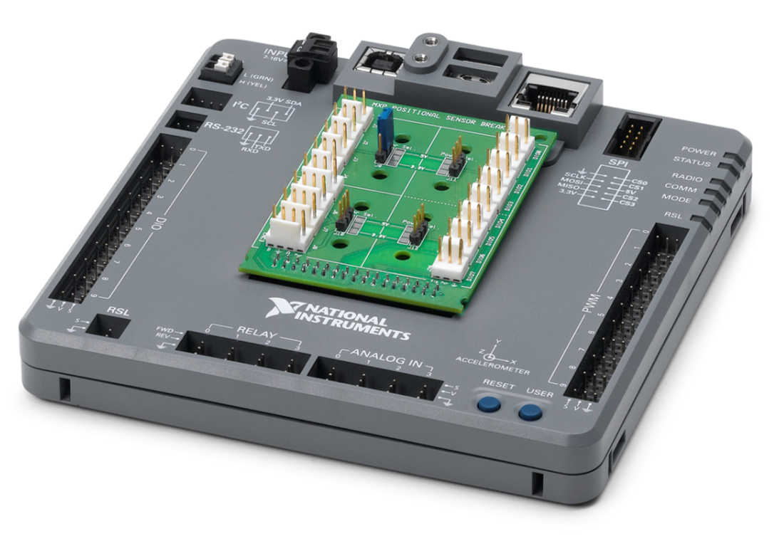
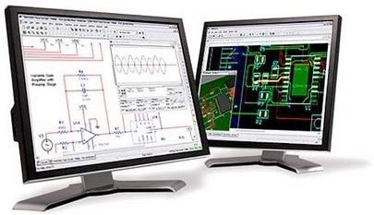
MXP – myRIO Expansion Port
Setup
Create your own expansion board for roboRIO
bit.ly/roboRIO-MXP
All FRC Teams get a Free License
for the NI Circuit Suite
Ultiboard PCB Design & Layout
Multisim Circuit SPICE & Simulation
10 PWM / DIO
I2C / SPI / UART
3.3V / 5V / GND
2 Analog Outputs
4 Analog Inputs
MXP I/O
Be sure to check the official rules from FISRT to make sure your accessories are competition legal
!
Notes:
The roboRIO includes an MXP myRIO Expansion Port so teams can design and build their own expansion boards if they want extra or customized Inputs and outputs. NI has provided a free license for Multisim circuit SPICE and simulation and Ultiboard PCB design and layout software. To learn how you can get the software visit ni.com/frc and go to the MXP Developers Guide. The MXP Developers Guide also includes all the info you will need to make your own MXP accessories, including engineering drawings, PinOuts, and much more.

Slide 21
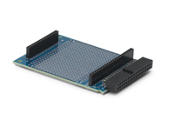
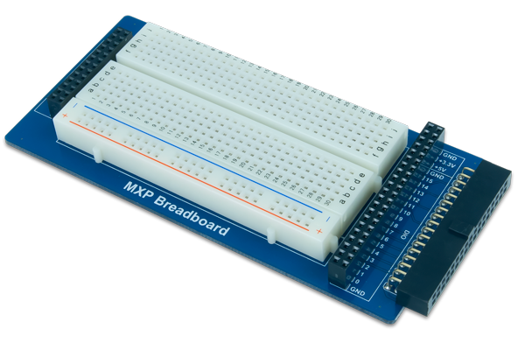

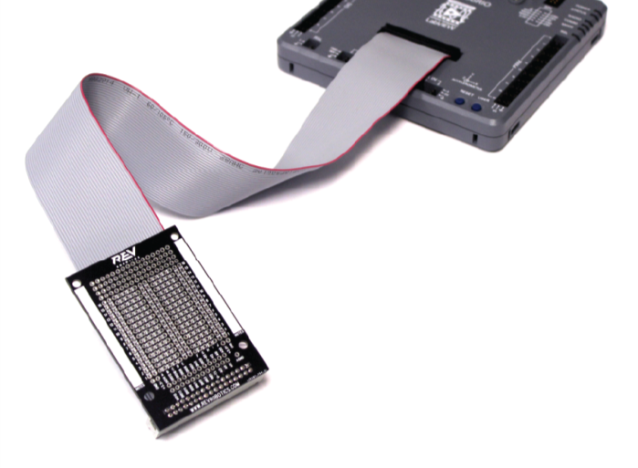
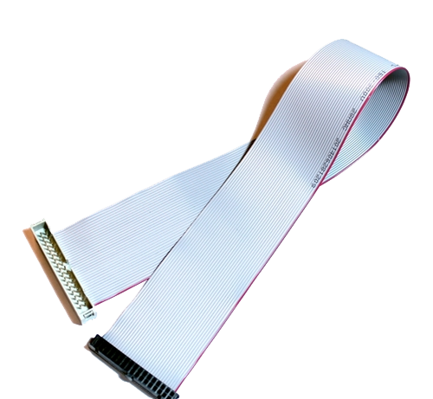
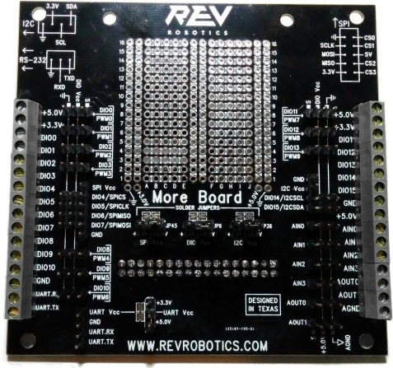
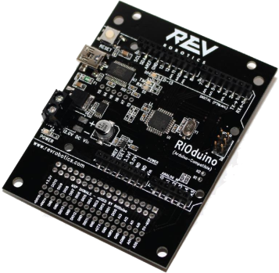
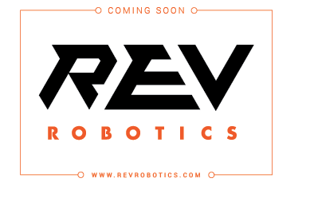
MXP Accessories
Setup
Adaptors and prototyping tools
Available from ni.com
Available from AndyMark
Create a roboRIO accessory? Let us know @NIFIRSTRobotics
Notes:
If your team doesn’t need to create custom circuitry for the MXP port, you can purchase a variety of development and prototyping tools so you can access the MXP I/O and more. NI sells a few adaptors made for myRIO, which uses the same MXP connector, note that the NI boards will stick out at 90° from the roboRIO. REV Robotics has created a growing line of MXP adaptors and accessories just for roboRIO. If you find other MXP accessories or your team creates your own please share them @NIFIRSTrobotics and we’ll post them all on ni.com/frc

Slide 22
Drive a Robot: Step 1 Open the Template Project
Setup
Step 1: From the LabVIEW Getting Started window, select New»FRC roboRIO Robot Project to create a new roboRIO Robot Project. (Step 0: Open LabVIEW for FRC.)
If you plan to use real hardware, you need to properly set up the roboRIO controller and D-Link before attempting the rest. You can run the project in simulation.
Notes:
In the next few slides, learn how to start driving in 5 steps. If you have LabVIEW and the FRC 2014 Utility Package installed, you can follow along. You can complete this tutorial with real hardware or with a simulated robot. You need a joystick to drive, so make sure yours is plugged in.
Open LabVIEW and start by creating a new roboRIO Robot Project.

Slide 23
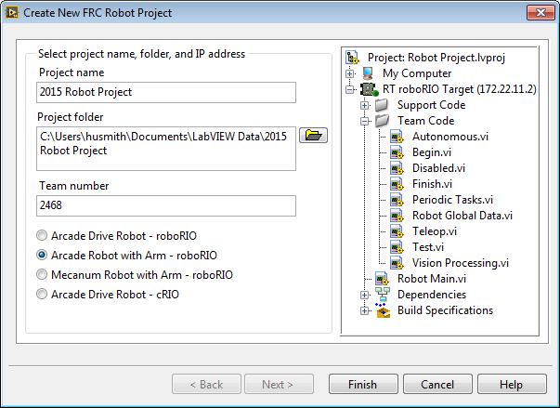
Drive a Robot: Step 2 Configure Your roboRIO Robot Project
Setup
Step 2: Fill in the New Project dialog box. Give the project a meaningful name, set your team number and pick the type of project you want to make.
Select project type based on your drive style and accessories
Notes:
After you create a new roboRIO Robot Project, you see this dialog.
Give your project a good name, specify where you want to save everything, set your Team Number which will be used to automatically generate an IP address, and select the drive style that most resembles your robot.

Slide 24
Drive a Robot: Step 3 Open the Template Project
Setup
If you add new VIs, be sure they are under the roboRIO target
The code you need to edit is in the Team Code folder
To drive your robot ,open Robot Main
Step 3: To open Robot Main.vi, double-click on it in the project window. The front panel should launch. Select <Ctrl-E> to open the block diagram and look at the code.
To Learn more about the Robot Framework Check out the Tutorial Here: https://decibel.ni.com/content/docs/DOC-26299
Notes:
The default project that is generated is already drivable as soon as you open it. The default code is simple and just has the drive modes implemented. By default, the autonomous code does nothing until you go in and edit it. Robot Main is the master program that deploys and runs all of the team code. For this exercise, you want to run just the default code, so open Robot Main by double-clicking on it.

Slide 25
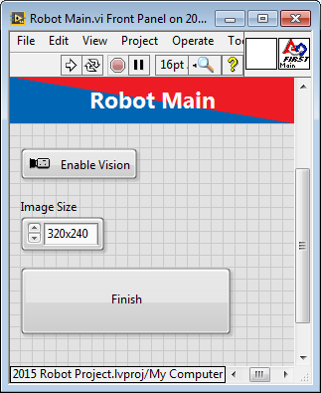
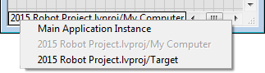
Drive a Robot: Step 4 Select a Target
Setup
Step 4: If you have a roboRIO controller connected, make sure you select it. If you don’t have an actual robot to drive around, you can still simulate one. Select the …lvproj/My Computer target to open the simulator.
Simulated roboRIO
Real roboRIO
Notes:
In the bottom left corner of both the front panel (grey) window and the block diagram (white), the target for execution is listed. To change the target, right-click on the white box and select your target. When you right-click, you’re changing the deployment environment. It may take a few minutes to load the simulation VIs.
Only a joystick is needed to simulate a robot.

Slide 26
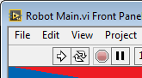
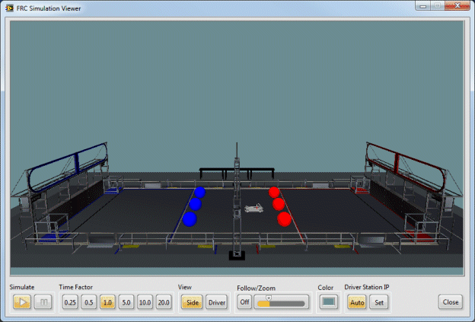
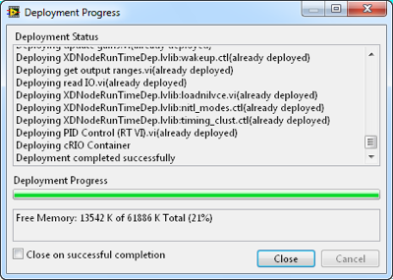
Driving a Robot: Step 5 Deploy Code
Setup
Step 5: Click on the white run arrow at the top left of Robot Main. The robot project is deployed to the roboRIO controller/simulator. Once LabVIEW is finished deploying the code, open the Driver Station. The LEDs should all be green. Click TeleOp and then Start.
Notes:
You can press the Run button from either the block diagram or front panel. LabVIEW must be able to establish a connection to the roboRIO controller to deploy to it.
If you are using a real robot, check the three lights in the Driver Station to make sure the joystick, robot code, and communication are all good before enabling TeleOp.
Once TeleOp is enabled, the robot is live!
Note: Since you ran the code instead of deploying it, the roboRIO controller runs the code only until it’s reset or power cycled. It does not start up automatically unless the application is built and set to run at startup.

Slide 27
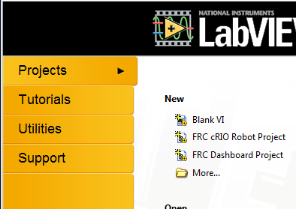
Setup Resources
Setup
Software Setup Guide
LabVIEW Development Suite for FRC 2015
Imaging roboRIO and Windows IP Configuration
Troubleshooting roboRIO Connections
Driver Station Tutorial
Custom Dashboard Tutorial
Robotics Framework Tutorial
Robot Simulation Tutorial
Forum Support (year round)
ni.com/frc
Phone Support (during build season only)
(866) 511-6285 from 1:00 to 7:00 p.m. (Central Time)
All links available at
ni.com/frc or
click this button
FRC LabVIEW Quick Start Guide
Notes:
This presentation is meant to give you a quick overview of all the systems. If you need more help on any of the steps covered, visit ni.com/frc and go to the LabVIEW training section.

Slide 28
FRC LabVIEW Quick Start Guide
What Is LabVIEW?
LabVIEW Development Environment
LabVIEW Programming Fundamentals
Tools and Troubleshooting
Teleop and Autonomous Code
Setup
NI LabVIEW
Basics
Vision,
PID, and Simulation
Advanced Programming
Notes:
The LabVIEW Basics module introduces you to the LabVIEW development environment and programming basics. Also explore some basic LabVIEW debugging techniques and look through some of the FRC-specific code.

Slide 29
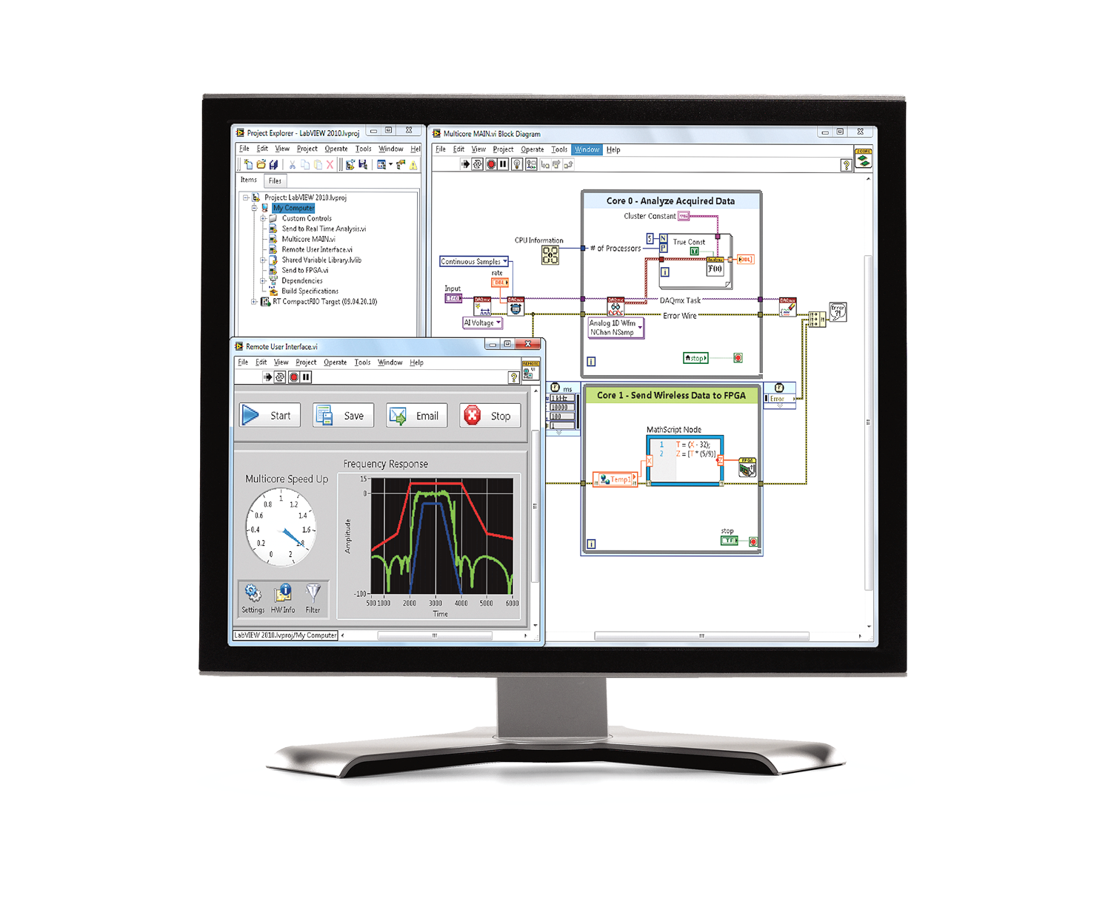
What Is LabVIEW?
LabVIEW
Basics
A graphical programming environment used to develop sophisticated measurement, test, and control systems
Graphical drag-and-drop code
(block diagram)
Rich user interface
(front panel)
Powerful built-in analysis libraries and tools
Notes:
The LabVIEW graphical programming language is different from traditional programming languages like C++ and Visual Basic. One of the greatest strengths of LabVIEW is how intuitive it is to program. You’ll see how the LabVIEW virtual instrument approach to programming makes it possible to create sophisticated and powerful programs with elegant, graphical user interfaces.

Slide 30
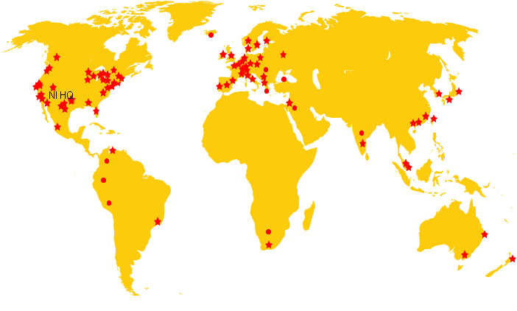



















































LabVIEW Usage in Universities
LabVIEW
Basics
110
Countries
7000+
Universities
Notes:
LabVIEW is used at High Schools, Colleges, and Universities around the world, from technical schools, to PhD programs. learning LabVIEW now will give you a leg up on college applications.

Slide 31







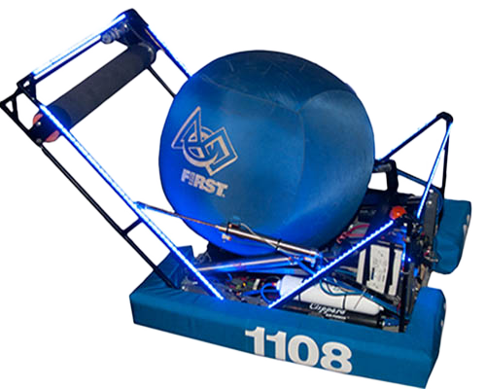
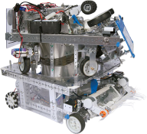
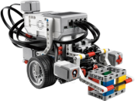
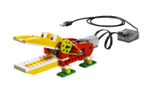
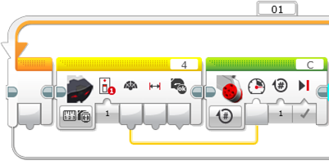
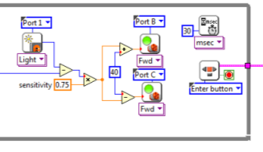




The LabVIEW Continuum
Career
Universities
Grade 9-12
Grade 7-12
Grade 4-8
K-3
WeDo
NXT-G, EV3
LVLM
LabVIEW
Notes:
NI has created a continuum of graphical design software that spans all FIRST competitions from Jr. FLL to FRC
[Animation]
Of course the LabVIEW continuum extends into college and a career as well where you can put your LabVIEW skills to work.

Slide 32









































































Companies that use LabVIEW
LabVIEW
Basics
More than 35,000 companies use NI Tools
Notes:
After you graduation there will be lots of opportunities to put your LabVIEW skills to use in a huge variety of companies from automotive, aerospace, semiconductor, green energy, food and many other industries.

Slide 33



Notes:
Here is an early version of SpaceX’s mission control room, almost every screen in this picture features LabVIEW. Can you spot the abort button in the top left corner?

Slide 34

The LabVIEW Environment
LabVIEW
Basics
Notes:
This video offers a general overview of the LabVIEW programming environment.
If the video is missing or won’t play in PowerPoint, watch it here: http://www.ni.com/academic/students/learn-labview/environment/

Slide 35



Parts of Robot Main.vi
LabVIEW
Basics
Front panel
(user interface)
Block diagram
(code)
LabVIEW Project Explorer
Notes:
During the next exercise, when you configure a new project in LabVIEW FRC, you can use a default code template. By using this template, you can drive the robot in Arcade mode without making any code changes.
In the coming slides, investigate the block diagram (code) of the Robot Main.vi to understand the key components and their functions.
The front panel is the user interface for the program where you place controls to input values to the system and indicators to display outputs to the user.
The block diagram contains the graphical source code.
Icon: Graphical representation of a VI
Connector Pane: Map of the inputs and outputs of a VI
You need the icon/connector panes to use a VI as a subVI. The connector pane is a map of the inputs and outputs of a VI.
A subVI is similar to a subroutine or function in a text-based programming language.

Slide 36

LabVIEW Project Explorer
LabVIEW
Basics
LabVIEW File Extensions
LabVIEW project—.lvproj
Virtual instrument (VI)—.vi
Custom control—.ctl
File location in Windows
Right-click to connect to roboRIO target
Notes:
You can use the LabVIEW project to access and organize project files. You view project files in the Project Explorer window. Project files can include LabVIEW and non-LabVIEW files.
You can use LabVIEW to build an executable and installer. Various hardware courses use the LabVIEW Project Explorer to configure and deploy applications to a target.

Slide 37

Parts of a VI: Front Panel
LabVIEW
Basics
The front panel is the VI’s graphical user interface with inputs and outputs.
Controls (inputs)
buttons,
knobs, slides...
Indicators (outputs)
numeric display,
graphs, LEDs…
Numeric control
LED indicator
Slider control
Boolean (on/off)
control
Notes:
Discuss how a front panel is the user interface of the VI and contains controls and indicators. A section following this slide concentrates on the front panel in more depth.

Slide 38



Controls Palette
LabVIEW
Basics
Search for controls
Right-click on the
front panel
(not the block diagram) to open the Controls Palette
Pin to keep open
Browse subpalettes
Notes:
With the Controls Palette, you can access all of the controls and indicators that are placed on the front panel. Right-click on the FRONT PANEL (not the block diagram) to browse the Controls Palette.
Use the thumbtack in the top left corner to lock the front panel so it stays open.
The modern, silver, classic, and system palettes all have a different look and feel, but they all function the same.
You can even create custom controls and indicators using your own graphics. There is a link to a tutorial in the references section.

Slide 39

Parts of a VI: Block Diagram
LabVIEW
Basics
The block diagram is the code for each VI. In LabVIEW, graphical blocks are connected with wires to control the execution.
Loop
Terminal
(front panel objects)
Function
Notes:
The block diagram is the graphical code that controls how the program executes. Block diagrams are composed of functions, terminals, and constants connected by wires. Like any programming language, LabVIEW has loops, Case structures, and conditional statements, but in LabVIEW, it’s all graphical.

Slide 40

Functions Palette
LabVIEW
Basics
Search for functions by name
Right-click on the block diagram (not the front panel) to open the Functions Palette
Contains the VIs, functions, and constants you use to create the block diagram
FRC-specific palettes include the WPI Robotics Library, FIRST Vision, and PID
Notes:
Open the Functions Palette by right-clicking on the BLOCK DIAGRAM (not the front panel). You can browse through hundreds of functions sorted by type or search directly for a function by name using the search button in the top right corner. When you install the FRC 2015 Update Package, you see a few extra palettes specific to FIRST.
The FIRST WPI Robotics Library, Vision, and PID palettes all include functions you need to program your robot.

Slide 41



Terminals
LabVIEW
Basics
With terminals, you can read and write to front panel controls and indicators.
Same name
Notes:
Data values you enter on the front panel controls enter the block diagram through the control terminals on the block diagram.
During execution, the output data values from the block diagram pass from indicator terminals to the front panel indicators.
Front panel items share the same label name as the block diagram terminal. When you change one, both change.
Note the visual difference between controls and indicators on the block diagram. The little arrow on the terminal shows where the wires connect. Controls output the value on the right side and indicators read the value from the left side.
Note that constants (the Triangular Multiplier) are available only on the block diagram.
You can right-click a terminal to change it between a control, indicator, or constant.
Terminals can be big or small. In this image, the Base terminal is large and shows the data type (double precision, DBL) and the control type (numeric). When the terminals are small, they show only the data type.

Slide 42


Dataflow Programming
LabVIEW
Basics
Turn on highlight execution
Order of execution is controlled by how the wires are connected
Each function executes when all of the inputs are ready
Parallel code executes at the same time
Notes:
LabVIEW uses dataflow programming, which dictates that the order of execution is controlled by how the nodes are wired together. Each function executes once all of the input parameters are ready. Code does not necessarily execute from left to right, but it is easier to read if you lay it out that way.
You can open up any VI and run it in highlight execution mode by clicking the little light bulb on the block diagram toolbar. This shows you how the code is executing as well as the intermediate values.
WARNING: When you run code in highlight execution mode, it SLOWS DOWN the execution speed dramatically. If you are using this with code running on the roboRIO controller, it causes a timeout on the FIRST safety features (watchdog).
More on dataflow programming: http://www.ni.com/gettingstarted/labviewbasics/dataflow.htm

Slide 43

LabVIEW Toolbar
LabVIEW
Basics
The tools you need to run, debug, clean up, and edit your code
Run tools
Front tool
Arrange tools
Debug tools
Broken arrow
(errors found)
Clean up
Notes:
The LabVIEW toolbar can be found on both the front panel and block diagram window. Some of the tools appear on both bars while others are specific to one window.
Click the Run button to run the VI. LabVIEW compiles the VI, if necessary. You can run a VI if the Run button appears as a solid white arrow.
[animation]
If the Run button appears broken, the VI contains edit-time errors. Click the broken arrow to display the errors.
The Run Tools include
Run—Execute the VI
Run Continuously—Execute the VI over and over
Abort—Quit the VI immediately (this should not be used as a normal stop button because it does not allow the code to stop nicely)
Pause—Halt the execution
Font tool—Font style, color, size, formatting, bold, and so on
Arrange tools—Align, distribute, and resize elements (just like in PowerPoint)
Align —Line up elements along one edge
Distribute—Spread a group of elements out evenly
Resize—IE makes all selected elements as narrow as the narrowest one
Debug Tools
Highlight Execution—Show dataflow execution
Retain Wire Values—Store executed values in the wire for debugging
Step Into, Step Over, step Out—Execute the VI one block at a time
Clean Up—Make the selected block diagram elements pretty

Slide 44

Wires (Data Types)
LabVIEW
Basics
Other examples of wires in LabVIEW
Floating point
Integer
Boolean
String
Array—note the wire thickness
Cluster (group of other data types)
Broken wire
(type mismatch)
Notes:
In LabVIEW, the color and width of the wires indicate the data type. Thicker wires indicate arrays.
These are all examples of different types of block diagram constants.
If you connect the two different data types or if you connect two inputs together, you get a broken wire. The image here shows that you have connected a floating point (orange) to a string (pink). See the little arrows next to the X.
Press <Ctrl-B> to clear all broken wires.

Slide 45



Loops
LabVIEW
Basics
Allow the same piece of code to run multiple times
Exit conditions are different for each
Run N times
While Loop
For Loop
Run until stop condition met
Iteration counter
Notes:
Use While Loops or For Loops to enable sections of your LabVIEW code to run repeatedly. A While Loop continues to execute until a stop condition is specified. The stop condition can be a simple button press or a series of specific logical conditions. The For Loop executes a predetermined number of times as specified by the number of iterations you wire to the N input. You may also connect an array wire to the edge of a For Loop and leave the N input unwired. The For Loop’s number of iterations is determined by the array size that is wired at its edge. This is called auto-indexing.
To find the While Loops and For Loops as well as other control structures left-click on any empty space on the block diagram and navigate to Programming»Structures.

Slide 46

Text-Based Math in LabVIEW
LabVIEW
Basics
Formula node
Right-click, select Help for syntax info
Notes:
Sometimes complex math is easier to understand as a text-based equation. With LabVIEW, you can combine text and graphical programming using the Formula Node. To place a Formula Node, browse to Mathematics»Scripts&Formulas and select the Formula Node from the Functions Palette. You draw a Formula Loop just like a While Loop in LabVIEW. As you add code, the run arrow indicates any syntax errors. Click the broken run error to see the specific errors. For a guide on syntax, right-click the Formula Node and select Help.
The Formula Node supports most common math functions as well as basic programming like While Loops, For Loops, if/else statements, and much more.
You can also find the Formula Node with search. Just search “formula.”
Formula Node tutorial
http://www.ni.com/white-paper/7572/en/

Slide 47



SubVIs
LabVIEW
Basics
Double-click a subVI to open it
Use the connector pane to connect controls and indicators
Connector pane
Notes:
In LabVIEW, you use subVIs to keep code looking clean and make code easy to read. You can double-click any subVI to see the underlying code.
In the top right corner of the front panel, you can see the connector pane, bind controls, and indicators to the connector pane terminals to help you wire inputs and outputs to the subVI.

Slide 48


LabVIEW Programming Demonstration
LabVIEW
Basics
Programming Demonstration
Front panel/block diagram
Tools/functions palettes
Controls/terminals
Wiring
Constants
Dropping functions
Run/run continuously
Loops
Data types
Highlight execution
Notes:
Take this time to implement a basic LabVIEW demonstration by re-creating the example above from a blank VI. Below is a scripted order that covers all of the programming basics teams learn in this module. Use this as a demonstration and not a group exercise to give a quick overview and save time. Be sure to narrate your mouse clicks (right versus left) and go slowly so you can show everyone once.
Demo Script
Start at the Getting Started window and select Blank VI
Show the block diagram and the front panel
Open the Controls Palette, drop a numeric control, and name it “A”
Drop a numeric slider, name it “B,” and show that the block diagram terminals change as well
Move over to the block diagram and drop two additional blocks
Wire A and B into the first addition
Wire the result into the second addition
Right-click on the second input of the addition and select Create»Constant (discuss controls versus constants)
Right-click on the output of the addition and select Create»Indicator (discuss controls versus indicators)
Set the numeric values and run the VI
Use Run continuously to show the difference and abort the VI (but caution against using abort in robot code)
Add a While Loop around the code, right-click on the stop terminal, and select Create»Control
Run the code and then use the Stop button to stop it
Right-click on the slider and change the representation to I32 (show that the slider locks to integers now, and the wire changed color)
Demonstrate highlight execution mode
Select the math code and select Edit»Create SubVI

Slide 49


How Do I Make Decisions in LabVIEW?
LabVIEW
Basics
Case Structures
Select
(a)
(b)
(c)
Notes:
You have several ways to make decisions in LabVIEW.
Case Structure
The Case structure has one or more subdiagrams, or cases, one of which executes when the structure executes. The value wired to the selector terminal determines which case to execute, and it can be Boolean, string, integer, or enumerated. Right-click the structure border to add or delete cases. Use the Labeling tool to enter value(s) in the case selector label and configure the value(s) handled by each case. Find it at Functions»Programming»Structures»Case Structure. This is equivalent to an If/Else or switch statement
Select
Returns the value wired to the t input or f input, depending on the value of s. If s is TRUE, this function returns the value wired to t. If s is FALSE, this function returns the value wired to f. The connector pane displays the default data types for this polymorphic function. Find it at Functions»Programming»Comparison»Select.
Example A: Boolean input. Simple if-then case. If the Boolean input is TRUE, the true case executes; otherwise the FALSE case executes.
Example B: Numeric input. The input value determines which box to execute. If out of range of the cases, LabVIEW chooses the default case.
Example C: When the Boolean passes a TRUE value to the Select VI, the value 5 is passed to the indicator. When the Boolean passes a FALSE value to the Select VI, 0 is passed to the indicator.
This is equivalent to the Question Mark (?) Operator in C++.

Slide 50

Introduction to Clusters
LabVIEW
Basics
Data structure that groups data together
Data may be of different types
Elements must be either all controls or all indicators
Thought of as wires bundled into a cable
Easier to bundle wires together and pass around as a group than wire each individually
Order is important
Notes:
Clusters group like or unlike components together. They are equivalent to a record in Pascal or a struct in ANSI C.
Cluster components may be of different data types.
Examples
Error information—Groups a Boolean error flag, a numeric error code, and an error source string to specify the exact error.
User information—Groups a string indicating a user’s name and an ID number specifying the user’s security code.
All elements of a cluster must be either controls or indicators. You cannot have a string control and a Boolean indicator. Think of clusters as grouping individual wires (data objects) together into a cable (cluster).

Slide 51


Cluster Functions
LabVIEW
Basics
In the Cluster & Variant subpalette of the Programming functions palette
Can also be accessed by right-clicking the cluster terminal
(terminal labels reflect data type)
Notes:
You can use bundle and unbundle functions to get data in and out of clusters.
The terms bundle and cluster are closely related in LabVIEW.
Example: You use a bundle function to create a cluster. You use an unbundle function to extract the parts of a cluster.
Bundle—Forms a cluster containing the given objects in the specified order.
Bundle By Name—Updates specific cluster object values (the object must have an owned label).
Unbundle—Splits a cluster into each of its individual elements by data type.
Unbundle By Name—Returns the cluster elements whose names you specify.

Slide 52
Building Arrays With Loops
LabVIEW
Basics
Auto-Indexing Enabled
Loops can accumulate arrays at their boundaries with auto-indexing
For Loops auto-index by default
While Loops output only the final value by default
Right-click tunnel and enable/disable auto-indexing
Wire becomes thicker
1D Array
0 1 2 3 4 5
Auto-Indexing Disabled
Wire remains the same size
Only one value (last iteration) is passed out of the loop
5
Notes:
For Loops and While Loops can index and accumulate arrays at their boundaries. This is known as auto-indexing.
The indexing point on the boundary is called a tunnel
The For Loop is auto-indexing-enabled by default
The While Loop is auto-indexing-disabled by default
Examples
Enable auto-indexing to collect values within the loop and build the array. All values are placed in the array upon exiting the loop.
Disable auto-indexing if you are interested only in the final value.
The index tunnels also work in reverse if you want to input an array and read one value on each iteration.

Slide 53

Shift Register: Access Previous Loop Data
LabVIEW
Basics
Available at left or right border of loop structures
Right-click the border and select Add Shift Register
Right terminal stores data on completion of iteration
Left terminal provides stored data at beginning of next iteration
Use for next iteration
Initial
Value
Notes:
Shift registers transfer data from one iteration to the next:
Right-click on the left or right side of a For Loop or a While Loop and select Add Shift Register.
The right terminal stores data at the end of an iteration. Data appears at the left terminal at the start of the next iteration.
A shift register adapts to any data type wired into it.
An input of 0 results in an output of 5 on the first iteration, 10 on the second iteration, and 15 on the third iteration. Said another way, shift registers are used to retain values from one iteration to the next. They are valuable for many applications that have memory or feedback between states.
See Help»Search the LabVIEW Help… for more information.

Slide 54


Context Help
LabVIEW
Basics
Click ? to open context help
Displays basic information about wires and nodes when you hover over with your mouse
Turn context help on/off
Click the yellow ? on the top right corner of your VI
Press <Ctrl-H>
Select Help»Show Context Help from the LabVIEW menu
Click for more info
Notes:
Context help is a very useful tool especially when you are using functions for the first time. Press the yellow question mark in the top right corner of your VI to open or close the window. Use your mouse to hover over a function or a wire to display information about it. You can click “Detailed help” to open up the Full LabVIEW help documentation with more information.

Slide 55

LabVIEW Help
LabVIEW
Basics
Contains detailed descriptions and instructions for most palettes, menus, tools, VIs, and functions.
Open LabVIEW Help by
Selecting Help»LabVIEW Help from the menu
Clicking the Detailed help link in the Context Help window
Right-clicking an object and selecting Help from the shortcut menu
Pressing F1
Notes:
The LabVIEW Help is full of useful information on how to use functions, tutorials, and tips. Open the help for a specific element from the Context Help, or by right-clicking and selecting help, or open the help and use the built in search tools to find the information you are looking for.

Slide 56

Find Examples
LabVIEW
Basics
Search by keyword
Find FRC templates in the Support Tab»Find FRC Examples…
Or Help»Find Examples and browse to the FRC Robotics Folder
Notes:
FRC LabVIEW includes hundreds of examples both specific to FRC as well as general LabVIEW examples. To open the example finder from the Getting Started window, select Support and click Find FRC Examples or from any LabVIEW Window select Help»Find Examples and browse to the FRC Robotics folder.
[animation]
All of the examples include instructions and configuration information so you can drop it into your Robot Project.

Slide 57

Debugging: Correcting Broken VIs
LabVIEW
Basics
Broken Run arrow»VI cannot be compiled»VI cannot be executed
Click to open Error List
Notes:
One of the most common debugging features used in LabVIEW is the compiler, which is always on. While you are developing a program, the compiler continuously checks for errors and provides semantic and syntactic feedback on the application.
When the Run button is not broken, the VI is compiled and can be executed. If an error exists, you cannot run the program. You see a broken Run button in the toolbar. The VI is not executable.
You must resolve any errors noted in the Errors List window before you can run the VI.
Instructors: This is a good opportunity to remind students that LabVIEW is a compiled language.

Slide 58


Debugging: Probes
LabVIEW
Basics
Use the Probe tool to observe intermediate data values and check the error output of VIs and functions, especially those performing I/O.
Specify to retain the values in the wires so that you can probe wires for data after execution.
Notes:
Probes allow you to see the value on a wire as a VI executes. Unlike highlight execution, this allows your code to operate at a normal speed so you can watch it run. Create as many probes as you need, and the corresponding number in the Probe Watch Window will display the data.
To create a probe, right-click on a wire and select “probe.”
More Details: http://zone.ni.com/reference/en-XX/help/371361H-01/lvhowto/using_the_probe_tool/

Slide 59



Teleop Code
LabVIEW
Basics
When modifying the FRC Robot Project template, do not modify Robot Main.vi.
Modify the code within the Team Code folder within the project. This code is called on in Robot Main.vi
Begin.vi
Teleop.vi
Finish.vi
Notes:
Now that you know the basics, explore the primary VIs you will be editing: Begin.vi
This subVI is called once at the start of the Robot Main.vi.
Its purpose is to initialize and define all of the motors, sensors, I/O, and other items connected to your robot.
The default FRC robot code initializes the camera settings, two motors, and joystick.
Turn on the Context Help by pressing <Ctrl-H>. Then hover over each function on the block diagram to see its name and description.
Teleop.vi
To see the block diagram of the Teleop subVI, select Teleop Enable in the Case structure and double-click it in the Robot Main VI. The front panel of the Teleop subVI opens.
Switch to its block diagram.
This is the code that reads the joystick and makes the robot move in Arcade Drive.
Finish.vi
To see the block diagram of the Finish subVI, select Finish in the Case structure and then double-click it in Robot Main VI.
The default FRC robot code closes the reference of the camera settings, two motors, and joystick.
Whenever you add a device to Begin.vi, you should also close that device in Finish.vi.

Slide 60

Autonomous Code
LabVIEW
Basics
Similar to Teleop, Autonomous executes code by references.
Begin.vi
Autonomous Independent.vi
Notes:
In Autonomous mode, the Robot Main runs the same Begin.vi. Then start your Autonomous Independent VI.

Slide 61

Learn Your Hotkeys
LabVIEW
Basics
Notes:
This is the LabVIEW Quick Reference Guide, which features helpful information about the LabVIEW environment and hotkeys. You can download this at ni.com/frc. I recommend printing one and keeping it in your programming area for use throughout the season.

Slide 62
Setup Resources
LabVIEW
Basics
Learn LabVIEW—Video Training
LabVIEW Environment Overview
Creating Custom Controls
LabVIEW Dataflow
LabVIEW Tools
LabVIEW Data Structures
LabVIEW Debugging
WPI Library Overview
Forum Support (year round)
ni.com/frc
Phone Support (during build season only)
(866) 511-6285 from 1:00 to 7:00 pm (Central Time)
All links available at
ni.com/frc or
click this button
FRC LabVIEW Quick Start Guide
Notes:
This presentation is a quick overview of all the systems. If you need more help on any of the steps, visit ni.com/frc and click on the FRC Quick Start Guide icon at the top. You can access this PowerPoint and all of the links for additional training info.

Slide 63
FRC LabVIEW Quick Start Guide
Vision
Code Overview
NI Vision Assistant
PID Control
What Is It?
LabVIEW PID
Robot Simulation
Setup
NI LabVIEW
Basics
Vision,
PID, and Simulation
Advanced Programming
Notes:
This module covers vision, proportional integral derivative (PID) control, and simulation. Though they are not required for competition, these tools help you build more advanced, smarter robots that can dynamically react to the game. These techniques are important in developing an advanced autonomous mode.

Slide 64

Vision
Vision,
PID, and Simulation
Vision,
& PID
NI provides vision tools to make your robot smarter.
Vision Uses
Locate colored objects
Locate shapes
Locate game elements
Calculate distances
Dashboard with vision controls
Notes:
LabVIEW includes a full suite of vision tools that you can use to set up and process images from your camera.
(with two cameras or if object size is known)

Slide 65


Vision Code
Vision,
PID, and Simulation
Image processing code
Select USB or IP Camera
Add Vision Code Here
Image data
Camera setup code
Notes:
To add vision code, you need to open Vision Processing.vi from the Team Code folder.
[Animation]
This is the block diagram for the Vision Processing VI.
[Animation]
The first part on the left is the camera setup. You can see you set the image size, frame rate, brightness, and other settings. You can also select if you want to use a USB webcam or IP camera by changing the Boolean constant.
[Animation]
You need to add some custom vision processing code inside this loop. You can pull the image data from the “Get Image function” and then use the data to update motors and other I/O or global variables.
You can create LabVIEW code by browsing through the vision palettes and placing functions, but I recommend using the NI Vision Assistant to create your initial algorithm.

Slide 66

NI Vision Assistant
Vision,
PID, and Simulation
Processing functions
Vision script
(LabVIEW code)
Start»Programs»National Instruments»NI Vision Assistant
Notes:
NI Vision Assistant is stand-alone software you can use to create a vision script that can be converted into LabVIEW code. To open it, browse to the Start menu path shown here or search for it by name from the Start menu.
With Vision Assistant, you can walk through each step in your algorithm and tweak the settings along the way. You can use a test image or pull a live image from your camera and then test your algorithm. Vision Assistant helps you quickly use “guess and check” to find the right functions, settings, and order to extract the data you need from the picture.
This image shows a vision script that finds the center of the red, green, and blue areas. You can then use that location data to calculate angles, distances, and perspective.

Slide 67




Vision Processing Algorithm
Vision,
PID, and Simulation
Develop a process to convert a camera image into useful data for your robot.
Segment/simplify
Convert to binary image
Clean up
Remove noise
Extract
Output IE: X,Y coordinates of each object
Notes:
You can simplify most vision processing algorithms into 3 steps. This example uses a sample image from the 2012 FRC of the basketball goal vision targets.
First, you need to segment or simplify the image so you have only the data you need. Typically, you start by converting your image to grayscale and using a threshold function to convert your image to a binary image (red and black). Most of the processing functions are designed to work with binary images.
Second, you need to clean up any stray objects or noise in your image. Once the image is binary, you can use functions to remove objects on the edge of the frame, remove small objects, or fill in shapes.
Finally, extract the objects you need from the image so you can output the useful data you need.

Slide 68









Vision Assistant Demonstration
Vision,
PID, and Simulation
Vision,
& PID
Select mode
Object Pixel Coordinates
Notes:
Here is a more detailed look at the example. Your goal is to find the X,Y coordinates for each of the four reflective targets.
[Animation]
First you need to acquire an image. When you first open Vision Assistant, it prompts you to open an image. You can either pull an image directly from your AXIS camera or open a saved image from file.
[Animation]
In this case, you want to open just an image from file and move over to the processing mode. You can always go back to Acquire Image if you want to grab a new image to try.
[Animation]
Once you have the image, use the Extract Plane Function to pick one of the color planes to use as a grayscale image. I tried the different colors and found that the Blue Pane had the most contrast compared to other planes.
[Animation]
Next, use the threshold function to extract the reflective vision targets. You can adjust the slider to find the best value. There are still several extra objects in the image, so use some other functions to clean it up.
[Animation]
You want to ignore any objects along the edge, so just use the remove edge objects mode of the Advanced Morphology function to clean them up.
[Animation]
Next use the remove small objects mode to get rid of the little splotches and shiny spots.
[Animation]
Now that you have the rough outline of each box, use the convex hull mode of the Advanced Morphology function to convert the detected areas to solid shapes.
[Animation]
There is still an extra little blob on the screen, so use the remove small objects mode again. Now you have big clear boxes for the main targets. In the left pane, you can see the iteration is set to 4 for this step, so it runs “remove small objects” four times in this one step. In many cases, changing the order of clean-up functions or repeating them changes how well they work, so be sure to try different combinations. This type of experimentation is what Vision Assistant is made for.
[Animation]
Finally using the Particle Analysis function, you can extract the position data for the four objects on the screen. This function can give you the center of mass, edge dimensions, height, width, angle, and much more for each block. The values are represented in pixels based on the input image size. Once you have the raw numbers, you can bring them into LabVIEW and use them to determine various robot parameters. For example, you can have the robot turn until a target is in the middle of the camera image.
It helps to have multiple pictures so you can try your algorithm from different positions, different lighting conditions, and other variations to make sure your algorithm is robust and works reliably.
(You can also open the example Rebound Rumble Vision Script.vascr from the Quick Start Module zip file and step through it in Vision Assistant.)

Slide 69





Generate Vision Code
Vision,
PID, and Simulation
Vision,
& PID
Generate LabVIEW Code
Notes:
Once you have tested your algorithm in Vision Assistant and you are happy with the results, you can export the script into a LabVIEW VI so you can paste it into your team code.
To export a VI, select Tools»Create LabVIEW VI…
[Animation]
First select LabVIEW 2013 f2, since that is the version you are using for FRC 2015, and browse to a path to save the generated VI.
[Animation]
You can then select the current script you are working on or select a saved script from file.
[Animation]
Then select the image control option for image source since you are going to paste this code into the existing FRC template rather than acquiring it directly.
[Animation]
Finally select which values you want to be able to change and monitor with controls and indicators. Click Finish to generate the VI.

Slide 70

Generated Code
Vision,
PID, and Simulation
Vision,
& PID
Code Generated From Vision Assistant
Delete the Open Image code and paste this into Vision Processing.vi in your team code.
Data output
Open image
Selected controls
Notes:
Here is the code you generated from Vision Assistant. The Open Image code on the left opens an image on disc. If you want to keep testing with disc images, use it. When you are ready to integrate the code into the FRC project, you will not need it, so delete the Open Image code.

Slide 71


Integrate Vision Code
Vision,
PID, and Simulation
Vision,
& PID
Paste generated code in Vision Processing.vi.
Use the Open Image function in Vision Processing.vi
Now you can do math and make decisions using the Data Output
Use Edit»Create SubVI to convert your algorithm to one function to keep your code clean
Open image
Edit> Create SubVI
Data output
Notes:
Paste your code into Vision Processing.vi. You now have the processed Data Output in your robot code, and you still need to add some math or decision making to make your robot respond to the images.
[Animation]
I recommend using Edit»Create SubVI to convert this algorithm into a subVI to keep your vision code clean. You can connect the input controls to dashboard variables so you can easily edit the parameters before or during a match.

Slide 72

LabVIEW Vision Examples
Vision,
PID, and Simulation
Help>Find Examples
2015 game-specific examples
Notes:
Be sure to check out the vision examples in NI Example Finder. Several of these examples can give you a great start.
There are two 2015 game-specific examples for this season.

Slide 73
Open Loop Vs Closed Loop
Vision,
PID, and Simulation
Do Something
Do Something
Check the response
Open Loop Control
Closed Loop Control
Notes:
Closed Loop control is the principle of using sensors or other inputs to make decisions rather than just operating based on time constraints.

Slide 74

Open Loop Control
Vision,
PID, and Simulation
Imagine filling a glass of water without looking
Potential Sources of Errors
Bottle glugging causes water to come out at different rates
There could already be some water in the glass
If the bottle is full, it pours differently than when it is partially full
Unless everything works exactly as you expect, you’ll end up with water on the floor or a half full glass (half empty?)
Pour out water bottle
Wait 3.5 seconds
Stop pouring
Notes:
Imagine trying to fill a glass of water from a bottle without looking. There are lots of reasons this could go wrong based on variations in how the bottle pours. What are some other factors that could play a factor in causing errors.

Slide 75
Closed Loop Control
Vision,
PID, and Simulation
Imagine filling a glass of water while looking
Pour water out
Check if the glass is full
Keep pouring or stop
Potential sources of errors are mitigated
Makes a closed loop
Pour water
Check if glass is full
Stop pouring
Notes:
If you use your eyes as a sensor you can close the loop so if there are any small differences you can compensate by pouring for more or less time. Question: What kind of closed loop control can a blind person use to make sure they fill up their glass without over pouring?
A: They can stick their finger in by the rim and feel when the water reaches the top, just like robotics there are different methods and sensors you can use to close the loop.
A smart person will always look at their glass to make sure they fill it up all the way without going over, and a smart programmer will always try to use closed loop control to make their programs more reliable in different conditions.

Slide 76

PID
Vision,
PID, and Simulation
PID is one methods of closed loop control
Proportional integral derivative
An algorithm used in a control feedback loop to regulate a process such as the motion of a motor or the flow through a valve
Output feeds back into the input
(closed-loop control)
Notes:
PID control is a fundamental engineering tool that you can use to control dynamic movements smoothly and efficiently.
PID is a common form of “closed-loop feedback,” meaning the input is set based on the current output.
To use PID, you need to be able to monitor the output, for instance, a potentiometer or encoder that can detect rotation.

Slide 77


PID in the Real World
Vision,
PID, and Simulation
Fast but shaky
Just right
Smooth but takes too long
Notes:
PID is used in many engineering systems in the real world. Consider having a giant cannon on a battleship, and you need to rotate it 90 deg. If you turn the rotation motor on full and then abruptly stop when it reaches the end, the cannon shakes violently when you stop it (red line). If you move it really smoothly, it might take too long (red line). Often it is fastest if you overshoot your target a little and go back (green line). Using PID, you can find the best movement profile for your system.
With PID, you can adjust the motor power while you monitor the current position. Tweak the P, I, and D coefficients to change the settings and find the best movement for your system.
PID is important when
The moving parts are large and heavy (like your robot)
For example, if you turn your robot to face a moving target, you don’t want it to violently jerk around.
You need precision balance

Slide 78

Tuning a Controller
Vision,
PID, and Simulation
Adjust the PID gains to the appropriate values for your specific system.
Decrease rise time and steady-state error.
Notes:
This graph shows the movement over time as the setpoint changes.
Rise time is the time it takes to reach a setpoint.
Overshoot is how far you go over.
Settling time is how long it takes to stabilize.
Steady-state error is how far off the measured value will be form the set point when it is allowed to settle for a long time.

Slide 79

Using PID in LabVIEW
Vision,
PID, and Simulation
The LabVIEW FRC PID Palette consists of four VIs:
PID
PID Setpoint Profile
PID Control Input Filter
PID Lead-Lag
Notes:
The only VI you need to construct a regular PID controller is the PID VI. The other VIs in this palette implement more advanced functions and can be useful for some specific applications.

Slide 80

PID in LabVIEW
Vision,
PID, and Simulation
Setpoint
Shift register required for PID
Coefficients set on front panel
NI Example Finder»General PID Simulator.vi
Notes:
Here is an example from the NI Example Finder called General PID Simulator.vi.

Slide 81


PID Example
Vision,
PID, and Simulation
Try the PID Simulator example.
Setpoint
PID coefficients
NI Example Finder»General PID Simulator.vi
Notes:
If you are new to the concept of pulse-width modulation (PWM), I recommend playing around with the PID Simulator example. Search “PID” in the example finder and select “General PID Simulator” to evaluate your ability to tune the P, I, and D coefficients to optimize the changes shown on the graph.

Slide 82
Closed Loop is not perfect
Vision,
PID, and Simulation
Encoders won’t detect if a wheel slips, they just measure how far the wheel rotates, Meacham wheels are even harder to measure as a distance.
Encoders don’t always work perfectly
If you are waiting for a bumper or line sensor and it doesn’t trigger, your robot may get stuck in its current mode
Light levels can change in different lighting scenarios (workshop VS arena)
Ultrasonic sensors can give bad readings
The key to good autonomous closed loop control is LOTS of testing in different scenarios.
Notes:
Using closed loop control will allow your program to be more dynamic, but it is not perfect so you should do lots of testing to make sure everything works the way you want it to under varying conditions.
When developing autonomous closed loop systems the key is testing with LOTS of different variables. Change light levels, starting position, bump the robot as it moves,

Slide 83
The Robotics Simulator
Vision,
PID, and Simulation
Speed up/slow down simulation
View settings
Notes:
The simulator offers the following options:
Simulate—Play/pause the simulator without stopping code execution.
Time Factor—For slower computers, increasing the time factor can help speed up the responsiveness of the robot drive.
View—From the “Driver” view, you see the stage as a competitor. From the “Side” view, you see the stage as a spectator.
Follow —Set camera focus on robot (ZOOM).
Color—Change the background color of the simulator.
Driver Station IP—Use a static IP address for the simulated robot. For most applications, you can leave it as “Auto.”

Slide 84
Deploy Code to Simulator
Vision,
PID, and Simulation
Start the Driver Station. You need it for real and simulated robots.
Right-click in the lower left corner of Robot Main.vi and choose 2015 Robot Project.lvproj/My Computer.
Run Robot Main.vi and note that the FRC Simulation Viewer opens.
Enable Teleop Mode to drive the simulated robot or enable Autonomous Mode for independent control.
Notes:
1. Start the Driver Station. You need it for both real and simulated robots.
Open Robot Main.vi (under the roboRIO context).
2. Right-click in the lower left corner of Robot Main.vi and choose 2015 Robot Project.lvproj/My Computer.
3. Wait a moment while some subVIs reload.
4. Run Robot Main.vi and note that the FRC Simulation Viewer opens.
The Driver Station should show that you are in Simulated Mode. You need to enable Teleop Mode to drive the simulated robot.
5. To run Robot Main.vi on the roboRIO controller, right-click in the lower left corner of Robot Main.vi and choose 2015 Robot Project.lvproj/RT roboRIO Target.
To switch back to the roboRIO controller, simply right-click in the lower left corner of Robot Main.vi again and choose 2015 Robot Project.lvproj/RT roboRIO Target.

Slide 85

Exercise: Deploy FRC roboRIO Robot Project
Vision,
PID, and Simulation
Deploy the default robot project to the simulator.
The Driver Station must be running.
Simulated camera view
Notes:
Exercise (15 Minutes)
Start the Driver Station—You need it for real and simulated robots.
Open your robot Project and Open Robot Main.vi.
Right-click in the lower left corner of Robot Main.vi and choose 2015 Robot Project.lvproj/My Computer.
Wait a moment while some subVIs reload
Run Robot Main.vi and note that the FRC Simulation Viewer opens.
The Driver Station should show that you are in Simulated Mode. You need to enable Teleop Mode to drive the simulated robot.

Slide 86
Deploy to Real FRC Robot
Vision,
PID, and Simulation
Right-click in the lower left corner of Robot Main.vi and choose 2015 Robot Project.lvproj/RT roboRIO Target.
Notes:
Now that you have developed your code and tested it with the simulator, deploy to a real FRC robot!

Slide 87
Vision, PID, and Simulation Resources
Vision,
PID, and Simulation
Configure an AXIS Camera
Image Processing Tutorial
Using Vision Targets
List of NI Vision Functions
LabVIEW PID Tutorial
PID Theory Explained
Robot Simulator Tutorial
Forum Support (year round)
ni.com/frc
Phone Support (during build season only)
(866) 511-6285 from 1:00 to 7:00 p.m. (Central Time)
All links available at
ni.com/frc or
click this button
FRC LabVIEW Quick Start Guide
Notes:
Configure an AXIS Camera
http://wpilib.screenstepslive.com/s/3120/m/8559/l/89729-configuring-an-axis-camera
Image Processing Tutorial
https://decibel.ni.com/content/docs/DOC-26318
Using Vision Targets
https://decibel.ni.com/content/docs/DOC-20173
List of NI Vision Functions
http://zone.ni.com/reference/en-XX/help/370281M-01/nivisionlvbasics/ni_vision_function_palettes/
LabVIEW PID Tutorial
https://decibel.ni.com/content/docs/DOC-26317
PID Theory Explained
http://www.ni.com/white-paper/3782/en/
Robot Simulator Tutorial
https://decibel.ni.com/content/docs/DOC-26300

Slide 88
FRC LabVIEW Quick Start Guide
Setup
Dashboard Customization
Dashboard Record and Playback
Event Error Logs
Performance
Autonomous Strategies
NI LabVIEW
Basics
Vision,
PID, and Simulation
Advanced Programming
Notes:
This module covers some advanced LabVIEW programming concepts.

Slide 89
Dashboard Customization
Advanced Programming
Start by opening an FRC Dashboard Project.
Notes:
If you want to display some of your custom data or add custom controls, you can customize your dashboard so you can see exactly what you need to compete and hide what you don’t need. To start, go to the Getting Started window and create a new FRC Dashboard Project.

Slide 90

Dashboard Customization
Advanced Programming
Additional robot controls & indicators
Color Picker
Notes:
Open the Dashboard main and add any controls or indicators you want. You can place them on any of the tabs to help you stay organized. Don’t add too much or your interface will be too cluttered at game time.
In this example, I added a color selector so I can pick the color my camera is looking for, a slider to adjust maximum robot speed, an indicator showing me how many discs I have in the hopper, and a return to home button.
Once you have placed controls and indicators on the front panel, you need to add some code in your roboRIO robot project to make them work.

Slide 91


Connecting Custom Variables to the Dashboard
Teleop.VI
PC Dashboard.VI
Notes:
Here is an example of the modified code in the roboRIO robot project. To display the Joystick values during teleop, add this code to the Teleop VI and use the (Smart Dashboard) SD Write Number.vi to send the data to the dashboard by name. Be sure the names are exactly the same or it might not work.
You can also modify Begin.vi, Finish.vi, or any other VI in the team code to make the data accessible via the dashboard.

Slide 92

Dashboard Record and Playback
Advanced Programming
Notes:
You can use the dashboard to easily record drive sessions and then play them back. This new feature helps you with the verification and testing phases of the robot. In addition, the record option makes it easier to spot any irregularities in your input or output data from the robot.

Slide 93

Record
Advanced Programming
Log Location: C:\Users\Public\Documents\FRC\Log Files\Dashboard
Notes:
To begin recording your current drive session, simply click on the red circle. The recording is stored at C:\Users\Public\Documents\FRC\Log Files\Dashboard.

Slide 94

Playback
Advanced Programming
Playback speed options
Playback timeline
Notes:
To play back your recordings, simply click on the green play triangle and select the log file you want to play back.
You can change your playback speed. You can speed up the playback to skip over unimportant parts and slow down the playback to monitor points of interest.

Slide 95

Troubleshooting: Driver Station Charts
Advanced Programming
Network Issues
Lost data packets
Data packet trip time
Programming Issues
CPU usage
Free RAM on roboRIO
Hardware Issue
Robot battery voltage
Notes:
If you keep losing your connection with your robot or if you are having communication and control issues, use the charts view on the Driver Station for useful info. If you are having network issues, you see a lot of lost data packets or a long trip time.
You can also use the FRC Driver Station Charts tab to view performance statistics. The roboRIO controller is a real-time controller, which means if it gets overloaded, it starts to drop low-priority tasks to keep the high-priority tasks on time. Network communication is a low-priority task, so it may be the first thing to stop working if the roboRIO CPU is overloaded. Ideally, CPU usage should be below 80%. Two common causes of CPU overload are:
Loops without delays in them
Loops with code that takes longer to run than the defined loop delay

Slide 96


Troubleshooting: Event Error Logs
Advanced Programming
Open Log Viewer
Notes:
After driving sessions, the Driver Station logs the low-level data of the robot network and notes if any errors occurred. These logs are extremely helpful in identifying errors that you may not capture in your robot code.
To view these logs, click on the Launch Viewer button on the Charts tab of the Driver Station.
Once in the Driver Station Log File Viewer, you can view logs on the left side of the screen. Notice that there are two tabs on the top.
Data and Events versus Time tab—Graphical representation that provides a “big picture” view of what happened when the robot was driving.
(continued…)

Slide 97

Troubleshooting: Event Error Logs
Advanced Programming
Log Location: C:\Users\Public\Documents\FRC\Log Files
Notes:
Event List tab—Lists representations of messages that provide more details on the events.
The Events List tab is particularly helpful in identifying Watchdog or Safety Config timeouts. In addition, it can provide valuable information in between matches when the robot fails to respond.

Slide 98


Debugging: Breakpoints
Advanced Programming
When you reach a breakpoint during execution, the VI pauses and the Pause button appears red.
(right-click Breakpoint»Set Breakpoint)
You can take the following actions at a breakpoint:
Single-step through execution using the single-stepping buttons.
Probe wires to check intermediate values.
Change the values of the front panel controls.
Click the Pause button to continue running to the next breakpoint or until the VI finishes running.
Breakpoint on a wire
Breakpoint on a SubVI
Notes:
Breakpoints can be useful when you are trying to track down bugs in your code.
Note: Breakpoints pause your code and set off watchdogs if you are running code on your roboRIO controller.

Slide 99

Performance
Advanced Programming
Tools»Profile»Performance and Memory
Notes:
Tools»Profile»Performance and Memory
If you want just the speed of a single VI, this may be an easier solution than editing Elapsed Times.vi. In this example, note that the average run time for Build Dashboard Data.vi is basically the same value you found in the previous slide.
Timing statistics—Displays the following statistics for the VI run time:
# Runs—Number of times that the VI completed a run. For global VIs, this time is the total number of times any of its controls were accessed.
Average—Average amount of time spent by the VI per run. This is the VI time divided by the number of runs.
Shortest—Minimum amount of time the VI spent in a run.
Longest—Maximum amount of time the VI spent in a run.
Memory usage—Displays statistics about the number of bytes and the number of independent memory blocks that a VI uses.
Avg Bytes—Average number of bytes used by the data space of the VI per run.
Min Bytes—Minimum number of bytes used by the data space of the VI for an individual run.
Max Bytes—Maximum number of bytes used by the data space of the VI for an individual run.
Avg Blocks—Average number of blocks used by the data space of the VI per run.
Min Blocks—Minimum number of blocks used by the data space of the VI for an individual run.
Max Blocks—Maximum number of blocks used by the data space of the VI for an individual run.

Slide 100
Watchdog
Advanced Programming
System Watchdog
Monitors communication from Driver Station
Turns off outputs if there is no robot communication in 100 ms
Causes
No communication—radio issues?
Slow communication—CPU overload?
Driver Station running too slowly—dashboard hogging CPU
Notes:
You need some type of watchdog as a safety mechanism.
The cause of a system watchdog is usually a communication issue.

Slide 101

Safety Config Timeouts
Advanced Programming
You can turn on/off safety timeouts
Available for RobotDrive, MotorControl, PWM, Relay, and Solenoid
Notes:
The Safety Config VIs were added as a suggested User Watchdog alternative. They are output specific, meaning they can be turned on or off (enabled or disabled) for individual outputs. Only enabled outputs that don’t update in time are affected.

Slide 102

Autonomous Strategies
Advanced Programming
Easiest Autonomous—Tell the robot to do the same thing every time!
Notes:
One of the easiest autonomous strategies for a team is to preprogram the robot’s movements.
Using the roboRIO robot template, you can follow the example above to preprogram your robot to always move in specific directions.
Although this is easy to implement, preprogramming your robot makes your robot unadaptable to any changes on the field or interference from other robots.
(continued…)

Slide 103


Autonomous Strategies
Advanced Programming
Closed-loop feedback
Notes:
A better way to implement your autonomous code is to provide your robot with sensor data and allow your robot to make decisions based on the sensor data.
For example, programmers can create global variables that are updated with sensor data so that the autonomous code can make smart decisions.
An ultrasonic sensor can let the robot know that a wall, an obstacle, or another robot is nearby.
A photoelectric sensor helps the robot detect and follow a line.

Slide 104
Advanced Programming Resources
Advanced Programming
Full FRC LabVIEW Training (Beginner and Advanced—4.5 Hours Each)
Programming for Performance
Sensor Fusion Tutorial
Autonomous Timed Movement
Forum Support (year round)
ni.com/frc
Phone Support (during build season only)
(866) 511-6285 from 1:00 to 7:00 p.m. (Central Time)
All links available at
ni.com/frc or
click this button
FRC LabVIEW Quick Start Guide
Notes:
Full FRC LabVIEW Training (Beginner and Advanced)
https://decibel.ni.com/content/docs/DOC-33629

Slide 105




















.com
Driver Station Ideas, and Offseason Projects
LABVIEW
ALL THE THINGS
Notes:
LabVIEWHacker.com is a resource site where you can find free drivers for all of you coolest consumer technology devices. Some of these devices could be used as part of your driver station or for fun off season projects. You can even connect an Arduino or Chipkit directly to roboRIO.
LabVIEWHacker.com will help you
LABVIEW ALL THE THINGS!

Slide 106






NI.com/FRC
Learn more about roboRIO & MXP
Download LabVIEW FRC and Update Suite
Additional training
Download FRC 2015 Software
FRC LabVIEW Quick Start Guide
NI FRC
Forums
LabVIEW Training
NI roboRIO
New controller for FRC 2015
Get help from NI engineers and other teams
Review this PowerPoint and a list of all links
@nifirstrobotics
nifirstrobotics
Notes:
Be sure to visit ni.com/frc for downloads, training, support, and information.

